Slide 1

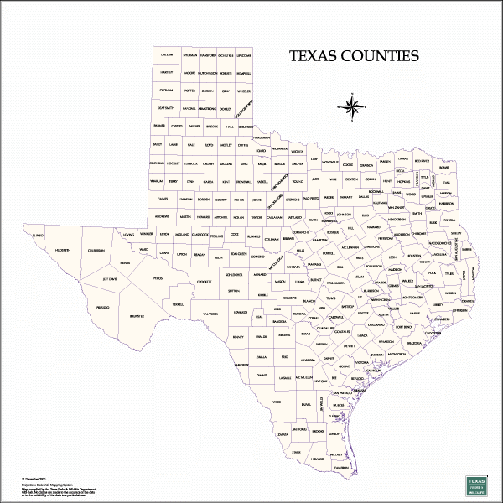
County Uniform Recidivism Measure Project
Progress Report and First Exploration of Big Picture Themes
Dr. Tony Fabelo
Jessy Tyler
Dr. Rebecca Cohen
Justice Center, Austin, Texas
Texas Association of Pretrial Services
Third Annual Conference
April 7, 2016

Slide 2
Overview
Background
Big Picture Themes
Evaluation Plan

Slide 3
Texas Urban Counties Uniform Recidivism Measurement
Goal
Uniform Definition
Compare the recidivism rate of criminal justice populations among the Texas urban counties
Re-arrest Rate
Standard Follow-up Period
Controlling for Risk Profile
Trigger a systematic conversation about furthering examinations to understand drivers of recidivism
Research-based risk measure developed by Justice Center from actual data to make comparisons controlling for the risk profiles of populations

Slide 4
Project Spearheaded by County CJ Leaders
Project started in 2013 as an idea of the Criminal Justice Urban Planners
This group represents the criminal justice planners from Bexar, Dallas, El Paso, Harris, Tarrant and Travis County
Bob Wessels, former county court administrator in Harris County, provided the initial guidance for the project
Mike Lozito, Bexar County; Ron Stretcher, Dallas County; Les Smith, Tarrant County; Caprice Cosper, Harris County; and Jose Landeros, El Paso County, were in the original group spearheading the county involvement

Slide 5
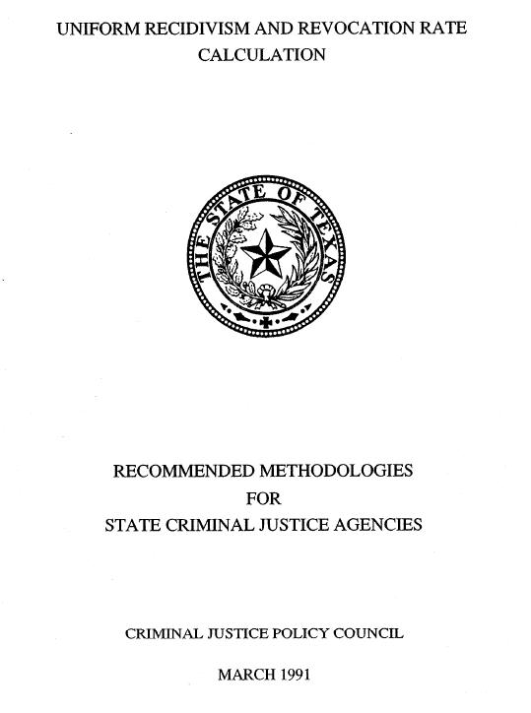


Populations and Tracking
Local Populations
State Populations
First Jail Release of the Year
Probation Placements, Regular and Deferred
Jail Releases on PR Bond or Commercial Bond
Prison Releases to the County
Jail Releases after Sentence Completion
State Jail Releases to the County
Re-arrested after one year
After two-years
After three-years
Clock ticks the same for all being followed

Slide 6
Three Different Groups Tracked Overtime
Short-Term and Long-Term Recidivism Comparisons
 | Year 1 | Year 2 | Year 3
2011 Cohort | One Year | Two Year | Three Year
2012 Cohort |  | One Year | Two Year
2013 Cohort |  |  | One Year

Slide 7
Population Risk Profile Developed for Each County
Research Based Risk Profile
Standardize Measure
Build a proxy risk score using static factors (age, gender, criminal history, etc.) from the county jail and criminal history files
Standardize computation of risk across counties without depending on risk assessment information
Percent New Offense within 3 Years by Risk Score
Sample

Slide 8
Actual Example from Tarrant County Analysis
One-Year Re-arrest Recidivism Rate by Risk Level for Local Populations in Tarrant County

Slide 9



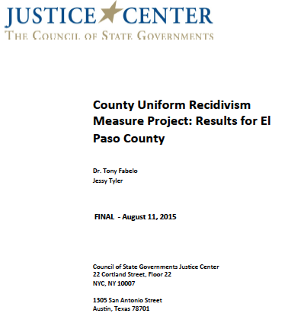


Comprehensive Reports to the Counties

Slide 10
Status of County Projects
Contract 1 | Contract 2 | Contract 3
2011 One Year | 2011 Two Year | 2011 Three Year
 | 2012 One Year | 2012 Two Year
 |  | 2013 One Year
Bexar, Dallas, El Paso, Harris, & Tarrant Completed | El Paso and Tarrant Completed Bexar in process | Dallas and Tarrant in draft review stage
Pending
Harris Year 2 and 3
El Paso Year 3
Bexar Year 3
Results from Dallas and Tarrant highlighted here because they are the only counties with three year results

Slide 11
Overview
Background
Big Picture Themes
Evaluation Plan

Slide 12
Controlling for Risk is Critical
1. Recidivism rates that do not control for risk of the population are not meaningful
2. Changes in the risk profile of a county or state population can greatly impact recidivism rates

Slide 13
County Population Risk Profiles
Distribution by Jail Population Risk Comparing Bexar, Dallas, El Paso, Harris, and Tarrant County, 2011

Slide 14
State Population Risk Profiles
Distribution of State Population Risk Comparing Bexar, Dallas, El Paso, Harris, and Tarrant County, 2011

Slide 15
Changing Risk Profile Can Impact Recidivism
Percent Low Risk
Percent Age 17-25
2011
17%
2011
37%
Personal Recognizant
Dallas
One-Year Recidivism
2012
29%
2012
30%
2013
32%
2013
29%
2011
31%
2012
20%
Percent White
Percent Property
2013
20%
2011
26%
2011
33%
2012
37%
2012
22%
2013
37%
2013
22%

Slide 16
No Significant Decline in Recidivism Rates
3. One-year recidivism rates, in general, did not decline for the release groups in 2011, 2012, 2013

Slide 17
One-Year Recidivism Rates – All Jail Releases
All Jail Releases
Dallas
Tarrant
El Paso
Bexar
Harris
2011
28%
26%
21%
22%
25%
2012
28%
27%
22%
22%
2013
28%
28%

Slide 18
One-Year Recidivism Rates
Pretrial and Commercial Bond
Pre-Trial Release
Dallas
Tarrant
El Paso
Bexar
Harris
During this period Dallas and El Paso did not have pretrial supervision
Bexar and Tarrant had pretrial supervision administered by the county
2011
27%
20%
29%
21%
15%
2012
30%
20%
30%
22%
2013
31%
18%
Commercial Bond Release
Dallas
Tarrant
El Paso
Bexar
Harris
2011
24%
24%
18%
23%
20%
2012
26%
26%
20%
23%
2013
25%
23%

Slide 19
One-Year Recidivism Rates
Probation and State Jail Releases
Placed on Probation
Dallas
Tarrant
El Paso
Bexar
Harris
2011
13%
10%
14%
15%
9%
2012
12%
10%
15%
15%
2013
11%
8%
Release from State Jail
Dallas
Tarrant
El Paso
Bexar
Harris
2011
39%
37%
37%
42%
43%
2012
43%
40%
35%
43%
2013
40%
39%

Slide 20
Recidivist with Multiple Arrests
4. About one-third of those who recidivated during the first year had two or more arrests

Slide 21
One-Year Recidivism Rates
Number of Rearrests
Percent Recidivating with Two Arrests or More During
One Year Recidivism 2013 Releases
2013
Dallas
Tarrant
Two or More Arrests All Jail Releases
31%
32%
Two or More Arrests Pretrial Releases
35%
24%
Two or More Arrests Commercial Bond
27%
29%
Dallas does not have pre-trial supervision
Tarrant has pre-trial supervision administered by the county

Slide 22
Half of Offenders Recidivate after Three Years
5. Three-year recidivism rates were high, with almost half of releases from jail recidivating
6. More than half of state jail releases recidivated after three-years
7. Probationers on deferred adjudication had higher three-year recidivism rates than regular probationers

Slide 23
Three-Year Recidivism Rates
Local Populations
All Jail Releases
After Jail Sentence
Dallas
Tarrant
Dallas
Tarrant
2011
45%
43%
2011
54%
54%
Pretrial
Commercial
Dallas
Tarrant
Dallas
Tarrant
2011
44%
35%
2011
40%
41%
Dallas does not have pre-trial supervision
Tarrant has pre-trial supervision administered by the county

Slide 24
Three-Year Recidivism Rates
State Populations
Deferred Adjudication
Regular Probation
Dallas
Tarrant
Dallas
Tarrant
2011
34%
33%
2011
23%
17%
Prison Release to Supervision
Dallas
Tarrant
2011
45%
43%
State Jail Releases
Prison Discharges
Dallas
Tarrant
Dallas
Tarrant
2011
59%
60%
2011
49%
50%

Slide 25
Most Recidivism Occurs First Year After Release
8. Of the population that recidivated during the three-year period, the largest proportion recidivate during the first year

Slide 26
Three-Year Recidivism Rates All Jail Releases
Percent Recidivating the First Year
Percent of Those Recidivating That Recidivated First Year
All Jail Releases
2011
Dallas
Tarrant
Number Recidivating During the Three-Year Period
11,682
11,133
Percent Recidivating First Year
61%
60%

Slide 27
Three-Year Recidivism Rates Pretrial/Commercial Bond
Percent Recidivating First Year
Percent of Those Recidivating That Recidivated First Year - Pre-Trial Releases
Percent of Those Recidivating That Recidivated First Year –Commercial Bond
2011
Dallas
Tarrant
2011
Dallas
Tarrant
Number Recidivating During the Three-Year Period
Number Recidivating During the Three-Year Period
573
687
5,582
7,312
Percent Recidivating First Year
62%
57%
Percent Recidivating First Year
62%
59%
Dallas does not have pre-trial supervision
Tarrant has pre-trial supervision administered by the county

Slide 28
Recidivist with More Severe Recidivism Offenses
9. About one-third of those who recidivate in the three-year period had at least one* re-arrest that was for a more severe offense than their offense of release
* Release offense is the offense at booking in jail which is the one available for our studies. Subsequent offense that was the most severe could be any of the subsequent offenses during the three-year follow-up period.

Slide 29
Three-Year Recidivism Rates All Jail Releases
Offense Severity Escalation
Percent of Those Recidivating – Severity Escalation
All Jail Releases
2011
Dallas
Tarrant
Number Recidivating During the Three-Year Period
11,682
11,682
11,133
Percent Subsequent Offense Arrest Higher Offense Severity Than Original
53%
53%
62%

Slide 30
Three-Year Recidivism Rates Pretrial/Commercial Bond
Offense Severity Escalation
Percent of Those Recidivating –
Severity Escalation
Pre-trial Releases
Percent of Those Recidivating –
Severity Escalation
Commercial Bond
2011
Dallas
Tarrant
2011
Dallas
Tarrant
Number Recidivating During the Three-Year Period
Number Recidivating During the Three-Year Period
573
687
5,852
7,312
Percent Subsequent Offense Arrest Higher Offense Severity Than Original
Percent Subsequent Offense Arrest Higher Offense Severity Than Original
60%
57%
49%
57%
Dallas does not have pre-trial supervision
Tarrant has pre-trial supervision administered by the county

Slide 31
Targeting High Risk Population Essence of Evidence Based Practices (EBP)
Proven Principles for Changing Criminal Behavior
Risk
Assess risk of re-offense and focus supervision on the highest-risk offenders
Needs
Assess and target the needs & problems related to criminal behavior that can change
Responsivity
Deliver in a way that maximizes meaningful understanding and retention by offender
Fidelity
Make sure evidence-based programs are implemented as designed
Results
Greater success changing criminal behavior and reducing re-offense rates

Slide 32
EBP Goal is to Impact High Risk Recidivism
Low Risk
+3%
Moderate Risk
-6%
High
Risk
-14%
Average Difference in Recidivism by Risk for Halfway House Offenders
Source: *Presentation by Ed Latessa, “What Works and What Doesn’t in Reducing Recidivism: Applying the Principles of Effective Intervention to Offender Reentry”

Slide 33
High-Risk Recidivism Rate Stable and High
10. One-Year Recidivism Rates for High Risk Offenders Did Not Decline
11. Three-Year Recidivism Rates for High Risk Offenders Were Very High for Certain Populations

Slide 34
One-Year Recidivism Rates – All Jail Releases
High Risk Population
All Jail Releases – High Risk Population
Dallas
Tarrant
El Paso
Bexar
Harris
2011
41%
40%
30%
36%
38%
2012
40%
43%
32%
36%
2013
41%
41%

Slide 35
Three-Year Recidivism Rates
High Risk Local Populations
High Risk
All Jail Releases
High Risk
After Jail Sentence
Dallas
Tarrant
Dallas
Tarrant
2011
64%
64%
2011
68%
71%
Pretrial
Commercial
High Risk
High Risk
Dallas
Tarrant
Dallas
Tarrant
2011
61%
58%
2011
62%
61%
Dallas does not have pre-trial supervision
Tarrant has pre-trial supervision administered by the county

Slide 36
Three-Year Recidivism Rates
High Risk State Populations
High Risk
Deferred Adjudication
Regular Probation
High Risk
Dallas
Tarrant
Dallas
Tarrant
2011
50%
51%
2011
53%
47%
Prison Release to Supervision
High Risk
Dallas
Tarrant
2011
64%
65%
High Risk
State Jail Releases
High Risk
Prison Discharges
Dallas
Tarrant
Dallas
Tarrant
2011
78%
75%
2011
71%
72%

Slide 37
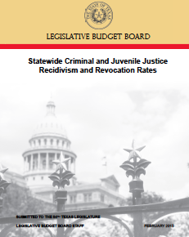
Three Year Statewide Re-arrest Rates for Prison Releases and State Jails Have Not Declined
Felony Re-Arrests from 2004-2011
Prisons and State Jails
State Jails
Prisons

Slide 38

Three Year Statewide Re-arrest Rates for ISF and Drug Treatment Programs Have Not Declined Either
Felony Re-Arrests from 2007-2011
SAFPs, TCs, and ISFs
Intermediate Sanction Facilities
In-prison Therapeutic Communities
Substance Abuse Felony Punishment

Slide 39
Overview
Background
Big Picture Themes
Evaluation Plan

Slide 40
Need for Evaluation Agenda at County Level
1. Identify major recidivism reduction programs or initiatives that have been adopted/sold
2. Start evaluating the largest of these initiatives to determine effectiveness
3. Generate recommendations for improvements with an accountability work plan to implement improvements

Slide 41
First Key Step is Agreement on Inventory
How many programs in county are targeting recidivism reduction as main goal?
Can program administrators track basic statistics like number of people served and number of people completing programs?
What are the target populations of these programs in terms of risk and needs?
What is the size of the different target populations?
How are outcomes defined and measured for the programs?
Need to Distinguish Programs Directed at Reducing Recidivism vs. “Services” for Offender Populations

Slide 42
Evaluation Needs to Examine Fidelity
Fidelity
Make sure evidence-based programs are implemented as designed
Program Effectiveness
What works with offender programming?
Based on proven, effective principles
Who:
Programs that target high-risk individuals are more likely to have a significant impact on recidivism.
Matched with correct client population
What:
Certain programs are more effective than others - effectiveness can relate to the type of program and where it is delivered (in a prison vs. in the community).
Implemented as designed
Staff trained in assessments and service delivery
Performance tracked and measured against expectations
How Well:
Assessing how well a program is executed can reveal whether or not a program has the capability to deliver evidence-based interventions.

Slide 43

Evaluation Needs to Examine if High Risk/Need is Targeted
Risk
Assessment
Low Risk
Mod/High Risk
Treatment
Assessment
Low to High
Treatment Needs
Low to High
Treatment Needs
Interventions
Standard Supervision
Enhanced
Supervision
Standard
Treatment
Enhanced
Treatment

Slide 44
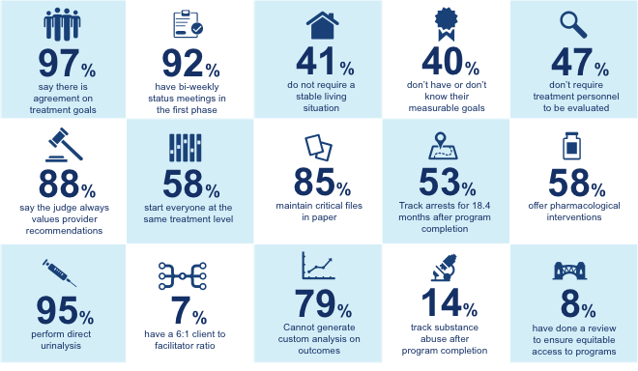
Best Practices - Example Texas Drug Courts
Governor’ s Office, Criminal Justice Division, based on survey of best practices by Texas A and M, Public Policy Research Institute as summarized by in a Governor’s office presentation, January 29, 2016

Slide 45
Size of Program Determine Impact of Overall Recidivism
Number of people disposed in Bexar courts during this period
2004-2012
Felony: 137,332
Misdemeanor: 398,794
Total: 536,126
Estimated number of people served by Bexar County Specialty Courts
2004-2012
1,617
1,617
536,126
= 0.3%

Slide 46
Specific Evaluation Designs Needed for Each Program
Example – Pretrial
Re-arrested after one year
One-Year Recidivism
Pretrial Supervision Period about Six Months
Need Six Month Recidivism Rate
FTA a Key Outcome Measure

Slide 47
Six Month Recidivism
2013
Six Month Recidivism
Dallas
Dallas does not have pre-trial supervision
All
Low
High
Pre-Trial
20%
11%
27%
Commercial
15%
6%
24%
2013
Six Month Recidivism
Tarrant
Tarrant has pre-trial supervision administered by the county
All
Low
High
Pre-Trial
11%
6%
20%
Commercial
15%
7%
24%

Slide 48
Comparison Groups Essential to Evaluations
Comparison
Participants
Share similar risk profile and demographics
Completed program
Did not complete program
Recidivism Rate
Recidivism Rate
Recidivism Rate

Slide 49
Overview
Background
Big Picture Themes
Evaluation Plan

Slide 50

Thank You
Tony Fabelo
Research Director
Jessy Tyler
Research Manager
jtyler@csg.org
512 470 5071

